Slide 1
Object Detection
CV Project - Team “Kuch bhi”
Team Members:
2018101033 - Jay Sharma
2018102021 - Tanmay Garg
2018102040 - Shantanu Agrawal
2020900019 - Anirudh Polatpally

Slide 2
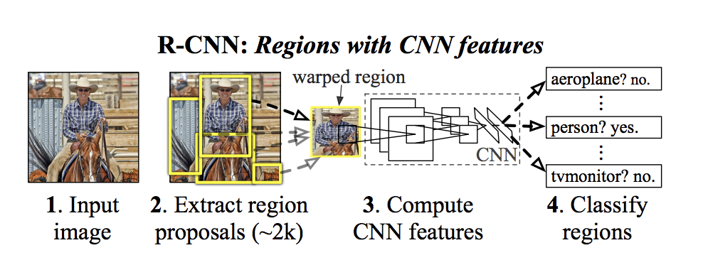
Method - Overview
Fig 1: RCNN workflow
Source: [1]

Slide 3
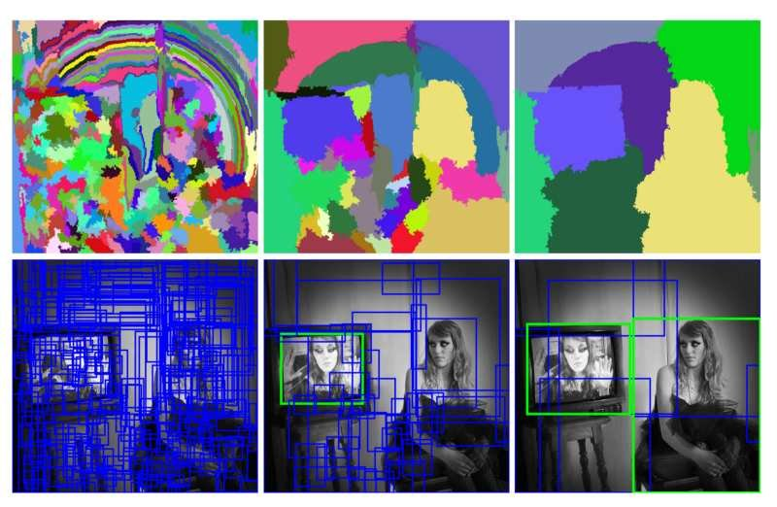
Region Proposals
Used Selective Search Algorithm
Generated a small set of region proposals from 10 images
Considered regions with IoU greater than 0.7
Obtained 401 proposals
Proposal dimensions - 224, 224, 3
Fig 2: Selective Search at different scales
Source: [2]

Slide 4
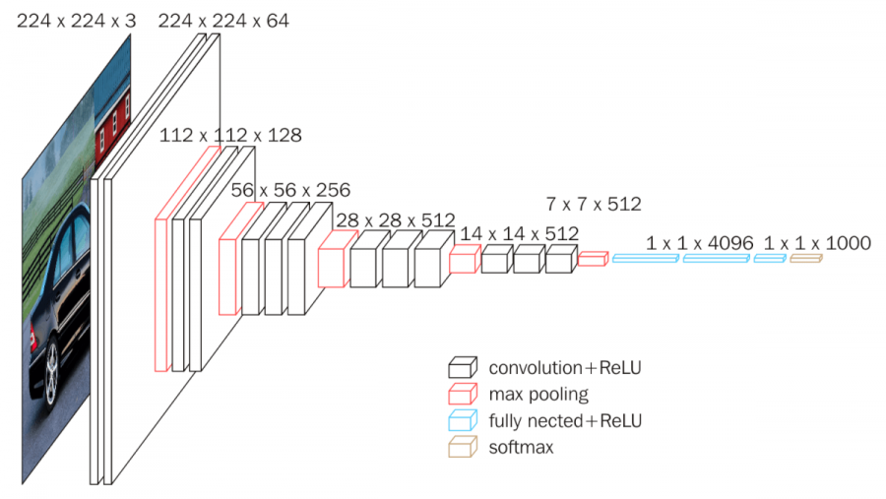
Feature Extraction - CNN
Used VGG-16 as backbone feature extractor.
3×3 convolutional layers stacked on top of each other
Maxpooling to reduce volume in between
Fully Connected layers at the end followed by softmax.
Final layers changed to perform classification and localisation.
Fig 3: VGG16, Source: [3]

Slide 5
Classification Head
linear(Input Size - 25088, Output Size - 4096)
ReLU
Dropout - 0.5
Perform Classification
Final output - scores for each of the classes in consideration (21 in our case)
linear(Input Size - 4096, Output Size - 4096)
ReLU
Dropout - 0.5
linear(Input Size - 4096, Output Size - Num_Classes)
Fig 4: Classification Head

Slide 6
Regression Head
linear(Input Size - 25088, Output Size - 4096)
ReLU
Dropout - 0.5
Perform Bounding Box Regression
Final output - Predicted Bounding Box (4 values)
linear(Input Size - 4096, Output Size - 4096)
ReLU
Dropout - 0.5
linear(Input Size - 4096, Output Size - 4)
Fig 5: Regression Head

Slide 7
Training
Classification Scores-
Trained on the proposals generated using selective search
Initially trained classification head, then followed by regression head.
Number of epochs | 8
Final loss | 5.6e-5
Final acc | 1
Regression Scores-
Number of epochs | 8
Final loss | 0.107
Final acc | -

Slide 8
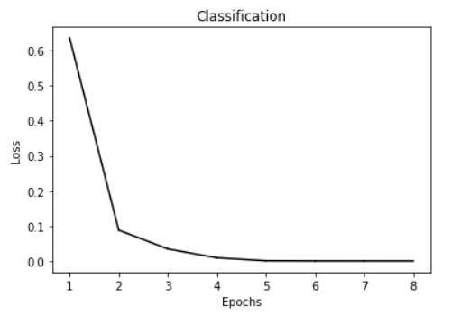
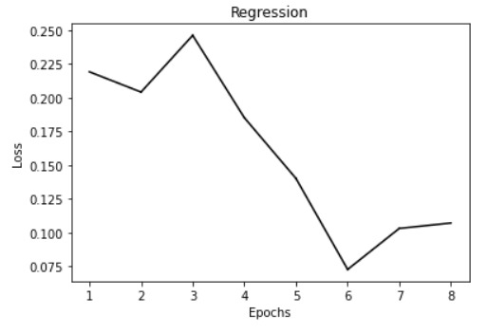
Losses

Slide 9
Non Maximum Suppression
Remove multiple bounding boxes
Remove boxes with low confidence
Select a box with highest confidence
Removes lower scoring boxes which have an IoU greater than iou_threshold with the highest scoring box

Slide 10
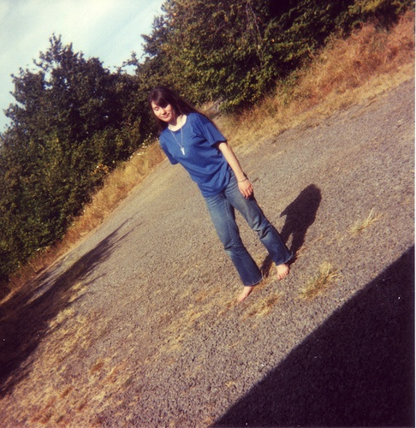
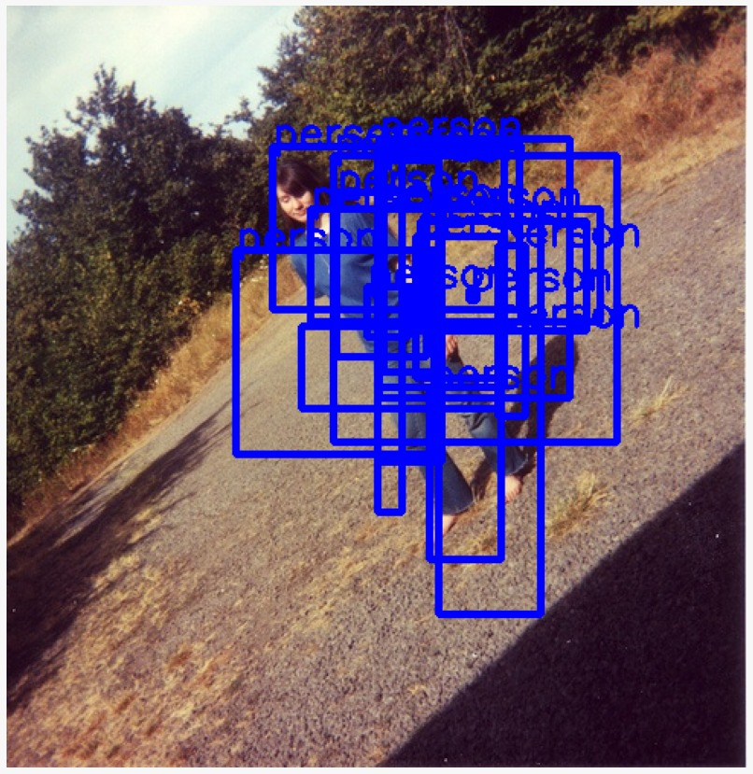
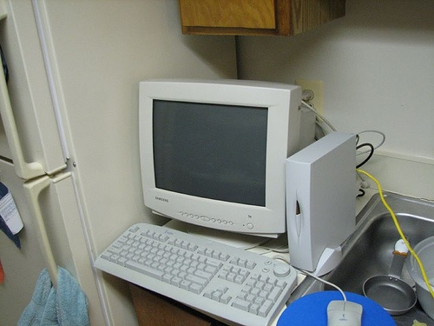
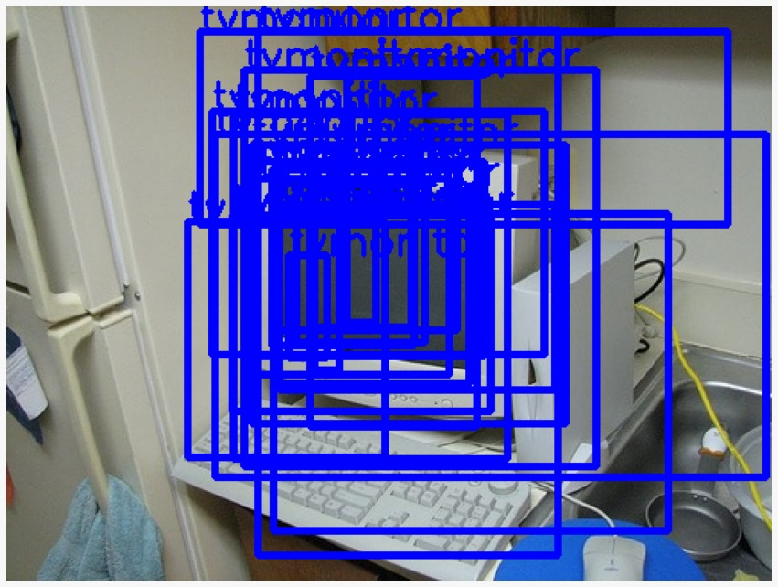
Tests
Tested the trained model with some of the proposal images

Slide 11
Up Next
Train the model for object detection on the entire dataset from scratch
Perform Ablation tests
Fine tune the model
Report Scores

Slide 12
Faster RCNN Experiment
The RCNN training time for any significantly big dataset (>1000 Image) is too high, and possibly infeasible with limited GPU resources, and lack of our understanding to compute selective search on GPUs.
Since the only thing different in faster RCNN is the RPN, we tried building it. We accomplished implementing various sized anchors, but could not complete RPN due to issues with our understanding, and the complexities of vectorizing everything to make training actually fast. Apart from this, the multi-stage non-end-to-end training regime was also seeming to be time-taking and complex, so we left it and got back to implementing RCNN.
If the training and prediction time for RCNN is remains too slow (which we suspect is most certain), and if time permits, we would try implementing Faster-RCNN once again, this time with a clearer base understanding of the architecture.

Slide 13
Reference(s)
Rich feature hierarchies for accurate object detection and semantic segmentation - Ross Girshick, Jeff Donahue, Trevor Darrell, Jitendra Malik (CVPR 2014) - Link
Selective Search for Object Recognition - Uijlings, Jasper & Sande, K. & Gevers, T. & Smeulders, A.W.M. (IJCV 2013) - Link
Very Deep Convolutional Networks for Large-Scale Image Recognition - Karen Simonyan, Andrew Zisserman (ICLR 2014) - Link

Slide 14
The End

